Slide 1
Tandem Repeat Variants in the Human genome
Gary Benson
Computer Science, Biology, Bioinformatics
Boston University
gbenson@bu.edu
http://tandem.bu.edu/

Slide 2
Outline
Define Tandem Repeats and Variants
Variant Detection
Reference Set
Variants Detected and their Characteristics
Invariant Tandem Repeats

Slide 3
Tandem Repeat
tcgctggtcata cgt cgt cgt cgt cgt tacaaacgtcttccgt

Slide 4
Tandem Repeat
tcgctggtcata cgt cgt cgt cgt cgt tacaaacgtcttccgt
1
2
3
4
5
left flank sequence
tandem array of copies
right flank sequence

Slide 5
Tandem Repeat
1
2
3
4
5
left flank sequence
tandem array of copies
right flank sequence
consensus sequence
1
2
3
4
5
multiple
alignment

Slide 6
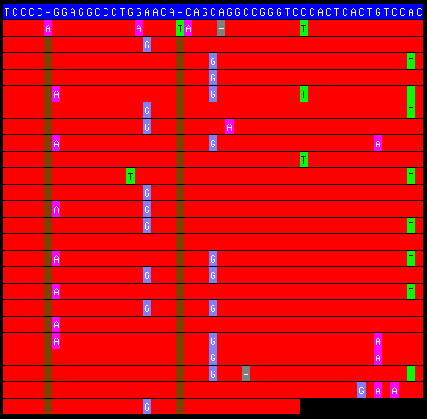
Typical Tandem Repeat showing multiple alignment and motif variants

Slide 7
Tandem Repeat Variants
Tandem Repeat polymorphisms occur as differences in:
individual copy motifs (SNPs/indels)
order of motifs in the tandem array
copy number (Variable Number of Tandem Repeats – VNTRs)

Slide 8
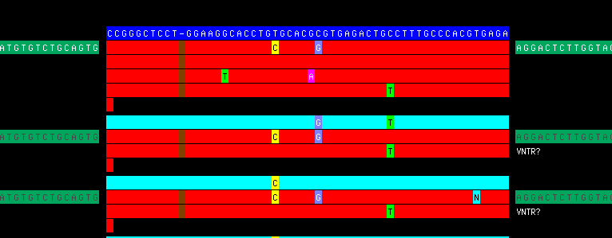
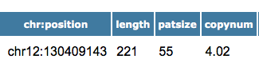
VNTR – One allele observed 2 copies shorter than reference
Reference
Reads

Slide 9
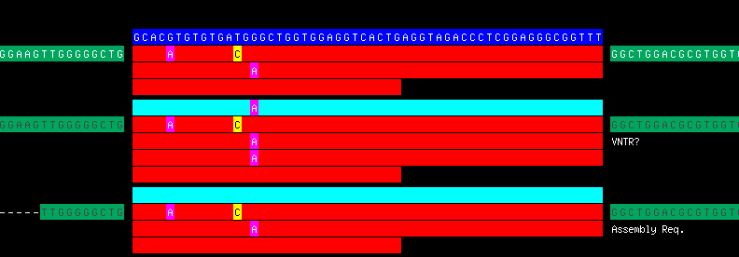
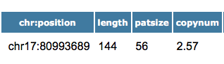
VNTR – Two alleles observed one same as reference

Slide 10
Why are Tandem Repeat Variants Important?
They are associated with human disease:
Triple repeat diseases
Fragile-X mental retardation
Myotonic dystrophy
Huntington’s disease
Friedreich’s ataxia
Epilepsy
Diabetes
Ovarian cancer
They co-occur with binding sites of DNA binding proteins and so may be involved in gene regulation.

Slide 11
Why is detecting variants difficult?
Read mapping in the presence of large indels (copy number difference) is computationally costly.
Motif differences (indels and SNPs) and motif order differences are additional complications for both seed indexing and BWT/Suffix Array matching approaches.
Mapping and indel detection is typically oblivious to sequence annotation.
There is a high frequency of repeat homology at distinct loci.

Slide 12
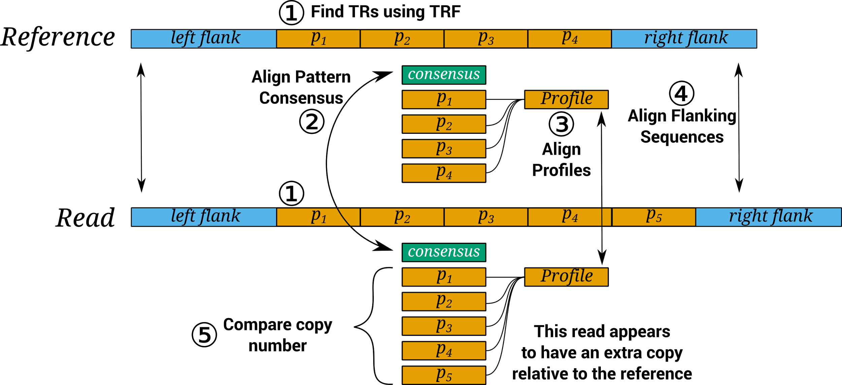
Schematic of VNTR Detection Strategy
VNTRseek – A Computational Tool to Detect Tandem Repeat Variants in High-Throughput Sequencing Data, Y. Gelfand, Y. Hernandez, J. Loving, and G. Benson, Nucleic Acids Research, 42(14):8884-8894, 2014.

Slide 13
Outline of Detection Strategy
Detect repeats in the subject and in the human reference using TRF software.
Map read-TRs to reference-TRs using:
indexing of reference consensus sequences
fast bit-parallel edit-distance with consensus sequences
profile alignment of TR arrays
flanking sequence alignment (bit-parallel)
Compare copy number of reference-TRs with those of mapped read-TRs and identify variants

Slide 14
Reference Set

Slide 15
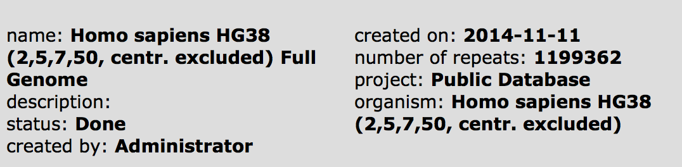
Reference tandem repeats come from the Tandem Repeats Database (TRDB).
https://tandem.bu.edu/cgi-bin/trdb/trdb.exe

Slide 16
Reference tandem repeats come from the Tandem Repeats Database (TRDB).
https://tandem.bu.edu/cgi-bin/trdb/trdb.exe
228,486

Slide 17
Filtering the reference set
Removed:
Low quality repeats
Redundant repeats
Repeats mapping to repeat masker features
Repeats that map to other repeats (using artificial reads)

Slide 18
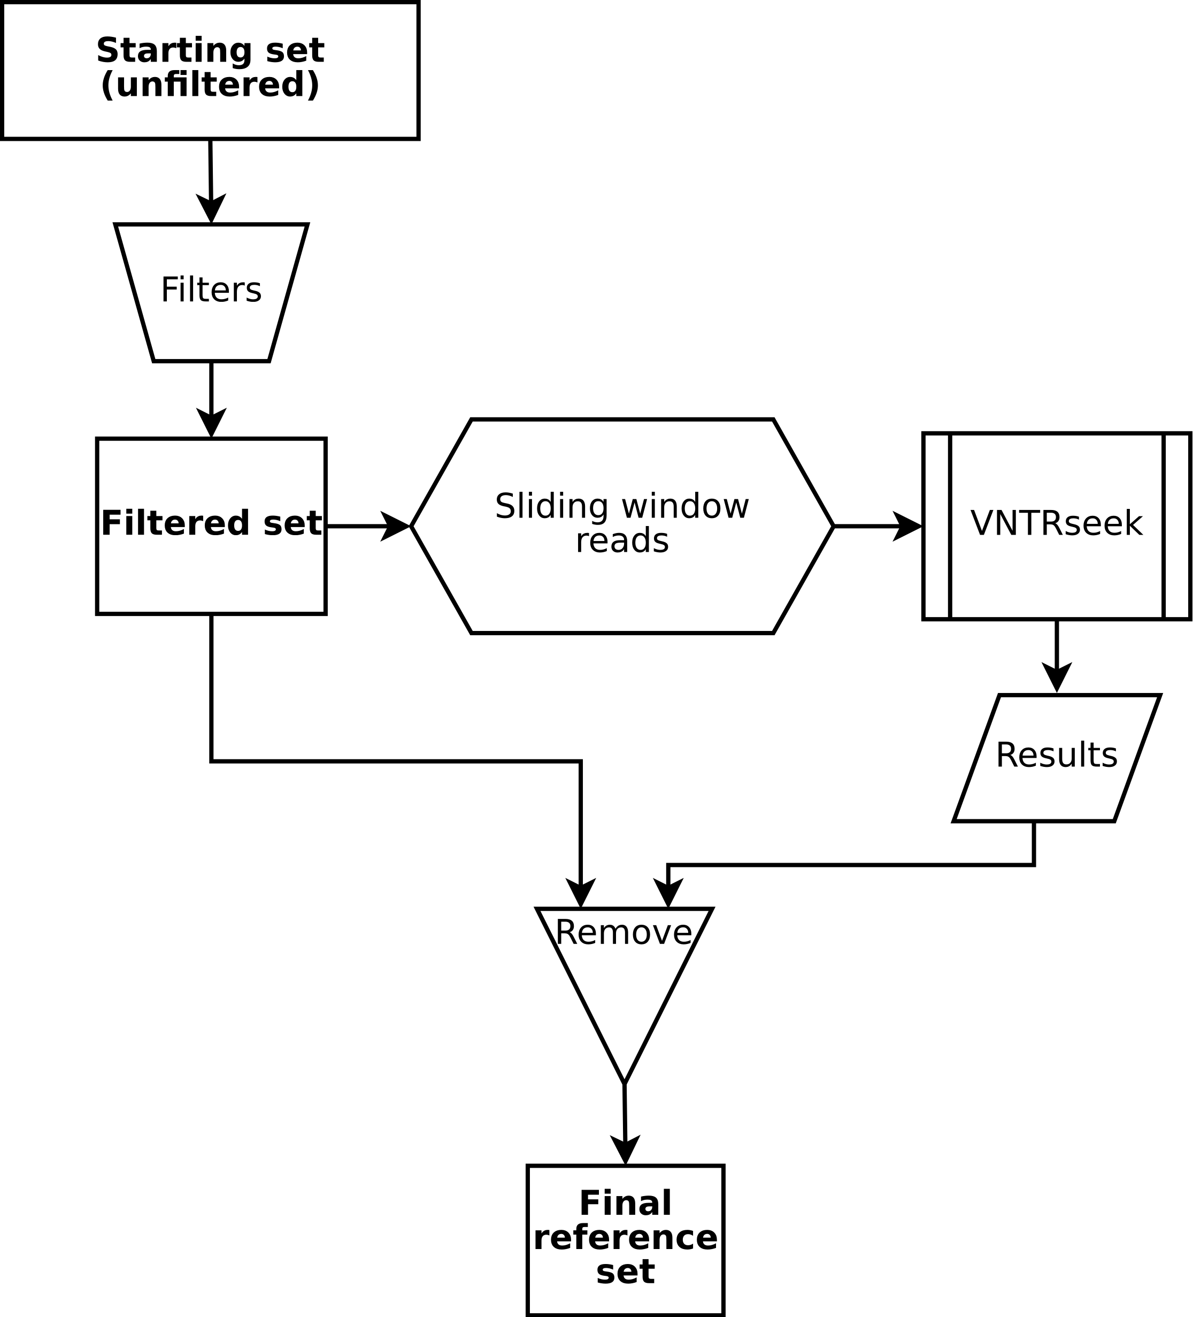
Filtering the reference set
low quality
redundant
repeatmasker annotated
reads map to
other repeats

Slide 19
Indistinguishable Reference TRs
Some tandem repeats exist in the genome which:
are highly similar to repeats at other loci
contain
similar consensus sequences
similar flanking sequences
presumably share a common ancestry
These repeats are identified by mapping the reference repeats to themselves and looking for repeats that have more than one mapping.

Slide 20
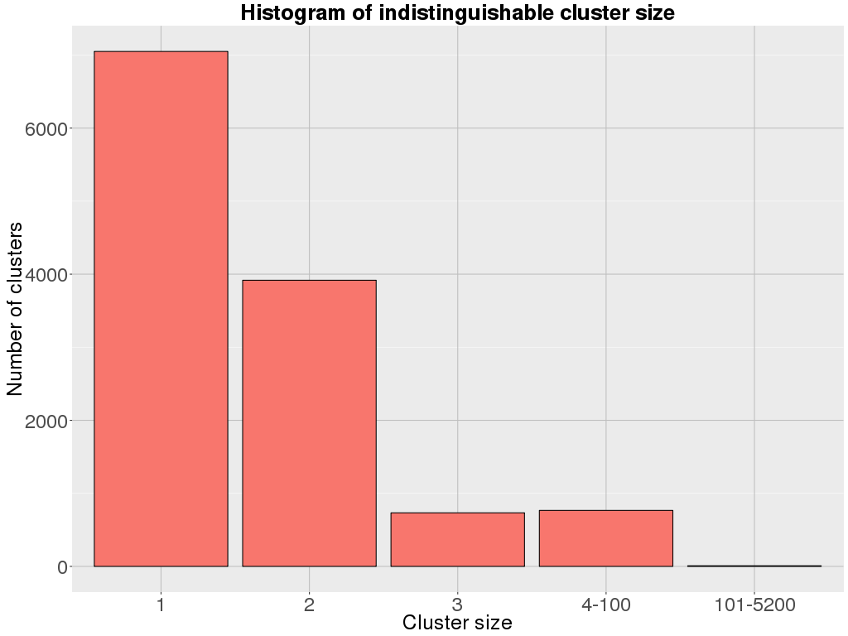
Size of Indistinguishable TR families
37,200 reference TRs are indistinguishable

Slide 21
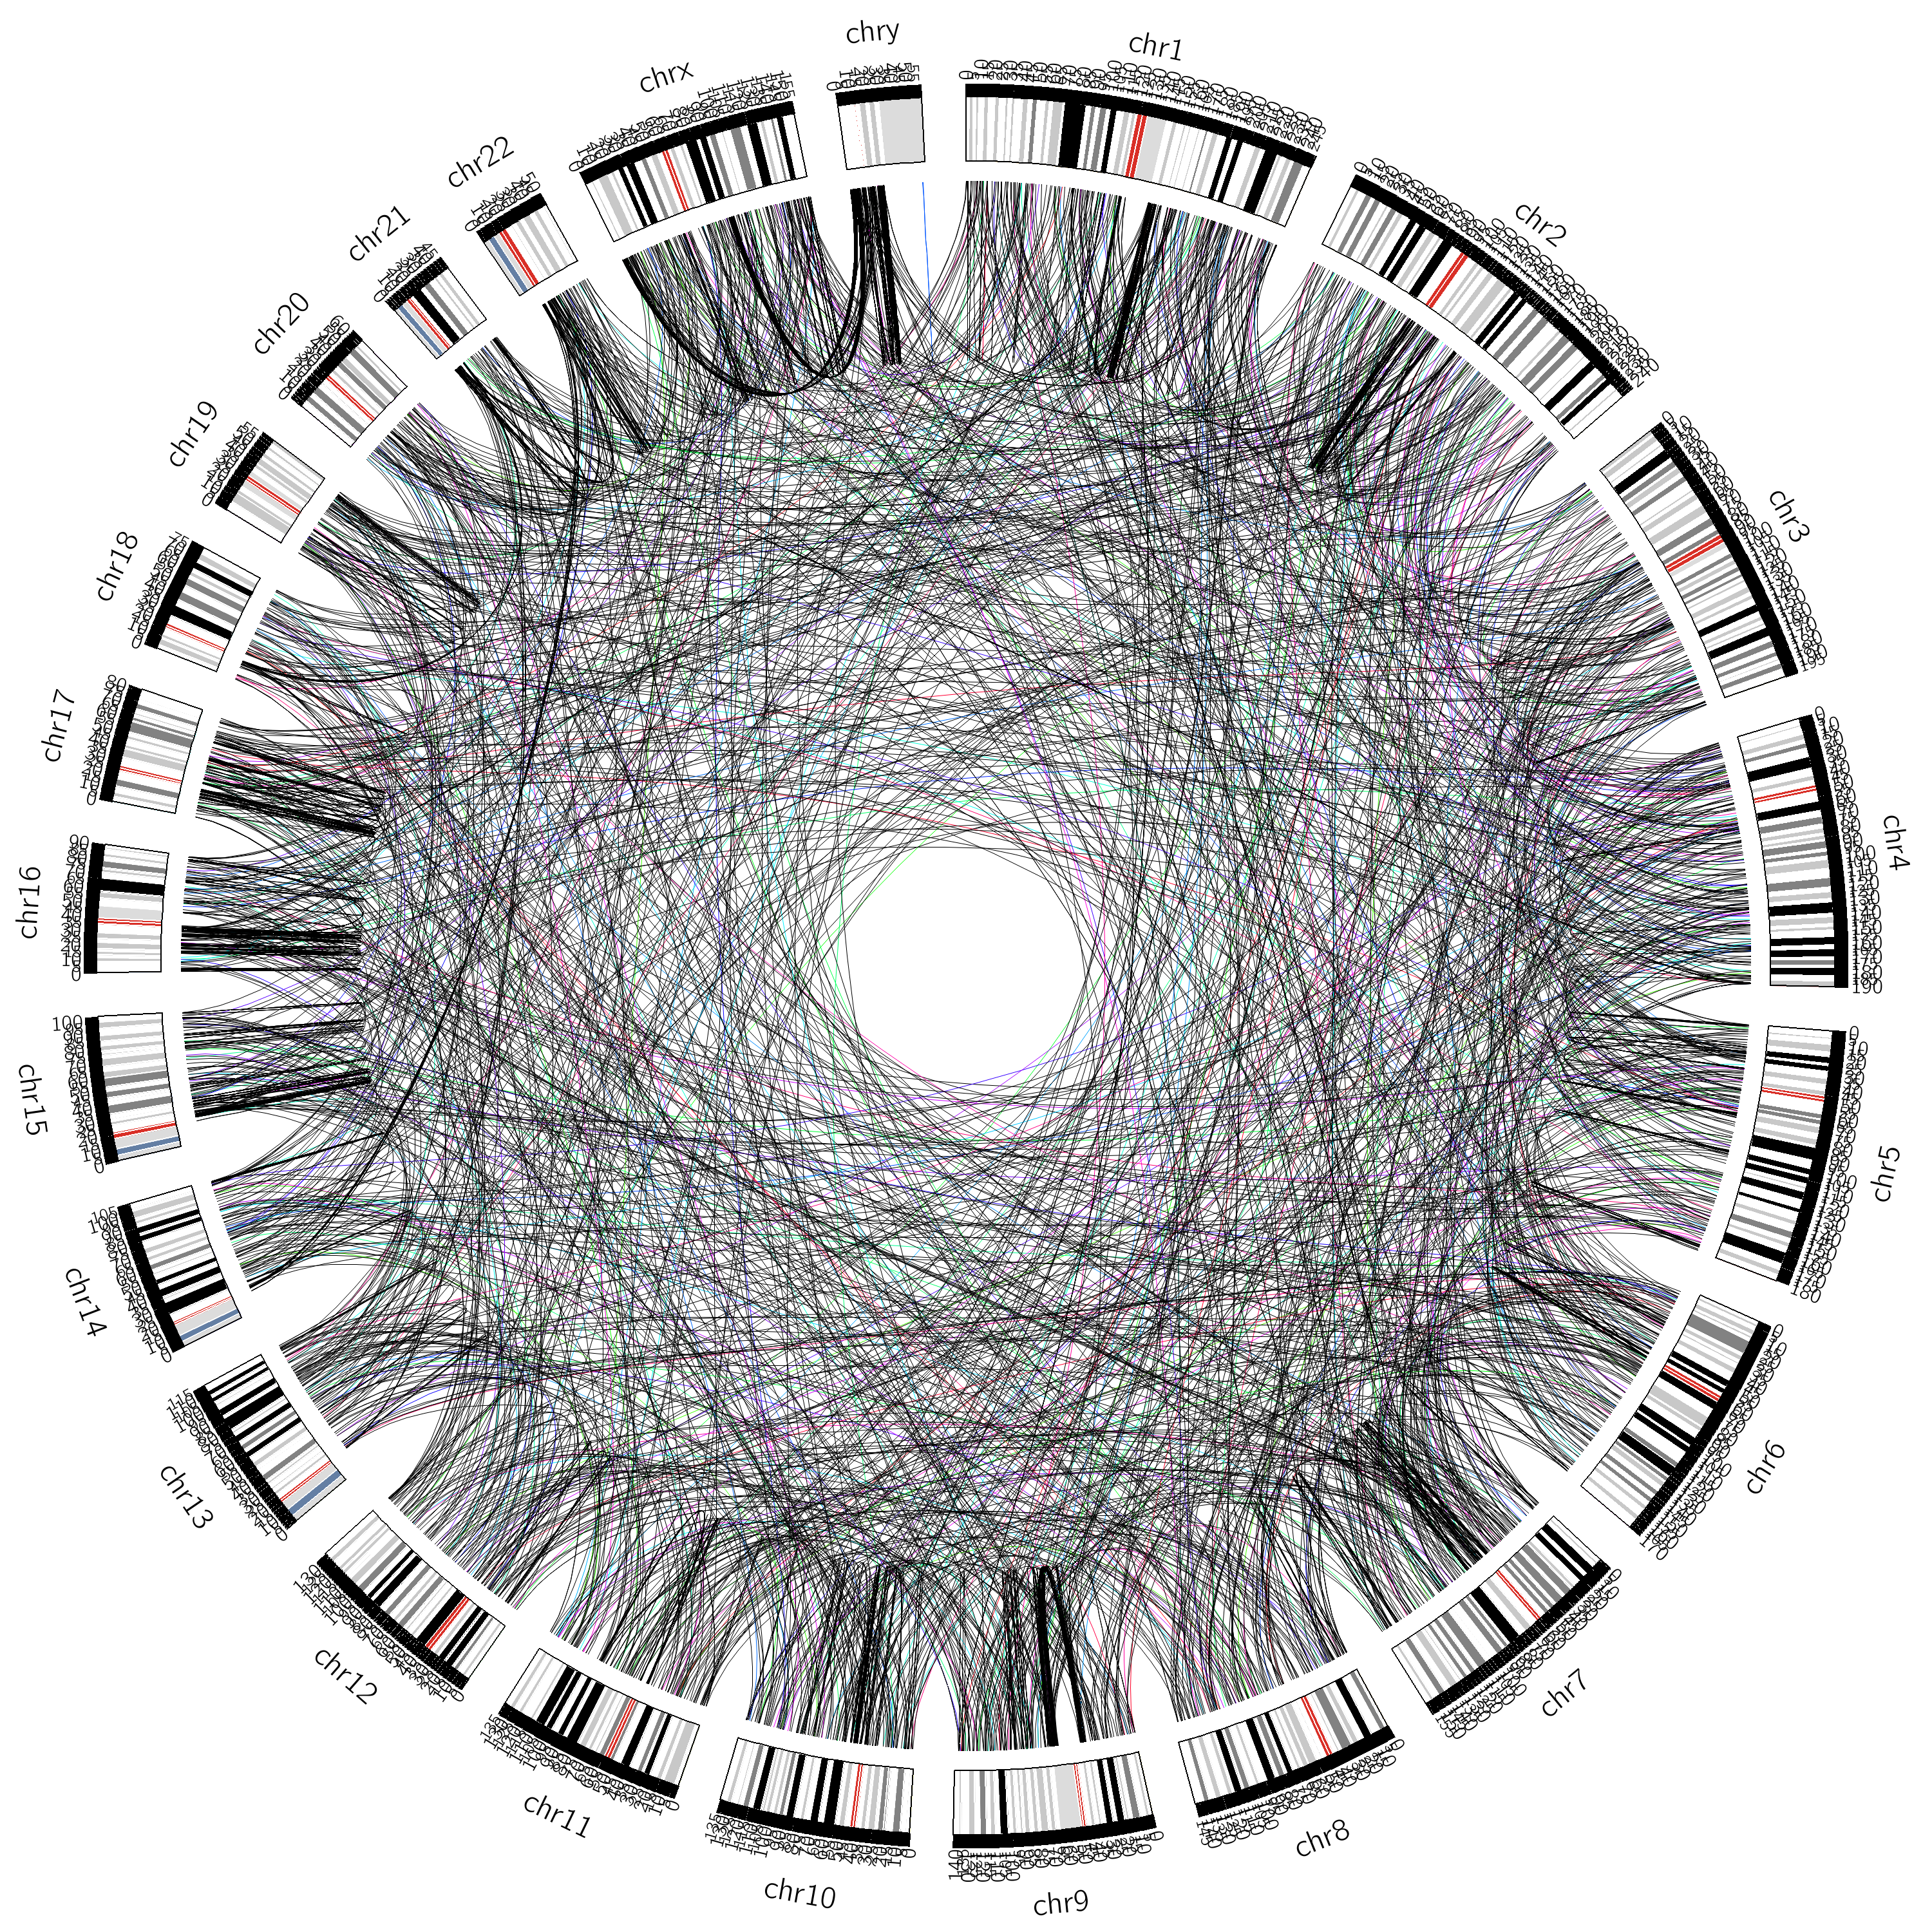
Indistinguishable TR Families with 2 members
3917
families
Notes:
Circos diagram of all clusters with 3 members in the reference set. Bins in drawing are 1 million bp so lines which appear to link back to themselves are linking back somewhere in a 1e6 bp range.

Slide 22
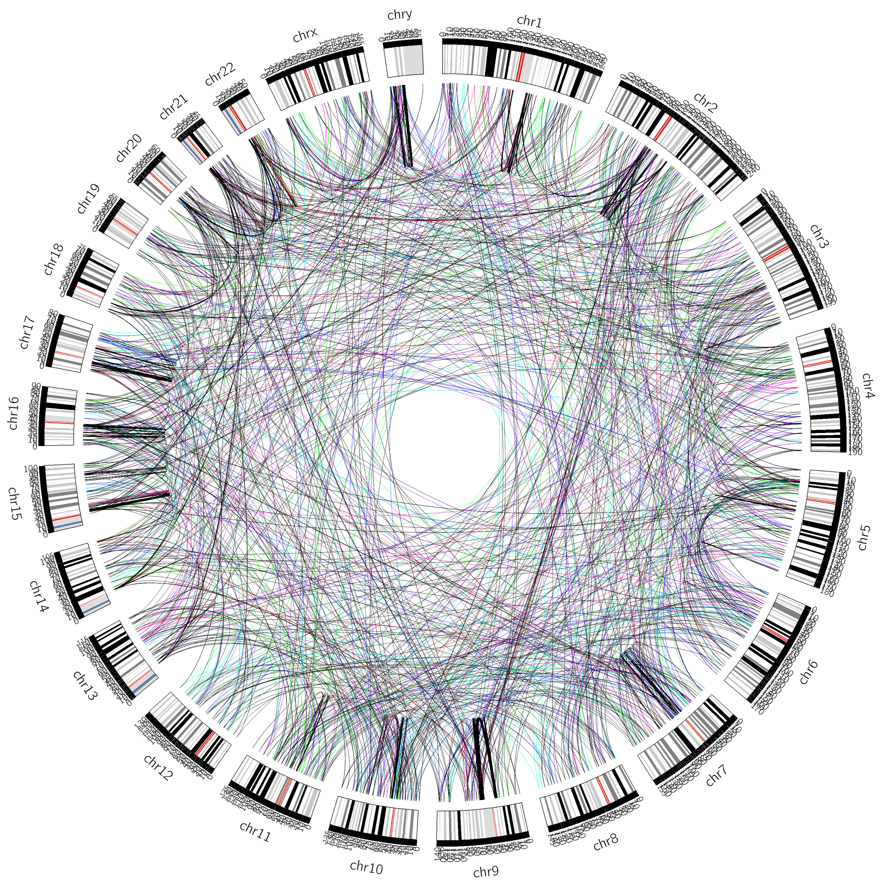
Indistinguishable TR Families with 3 members
733
families
Notes:
Circos diagram of all clusters with 3 members in the reference set. Bins in drawing are 1 million bp so lines which appear to link back to themselves are linking back somewhere in a 1e6 bp range.

Slide 23
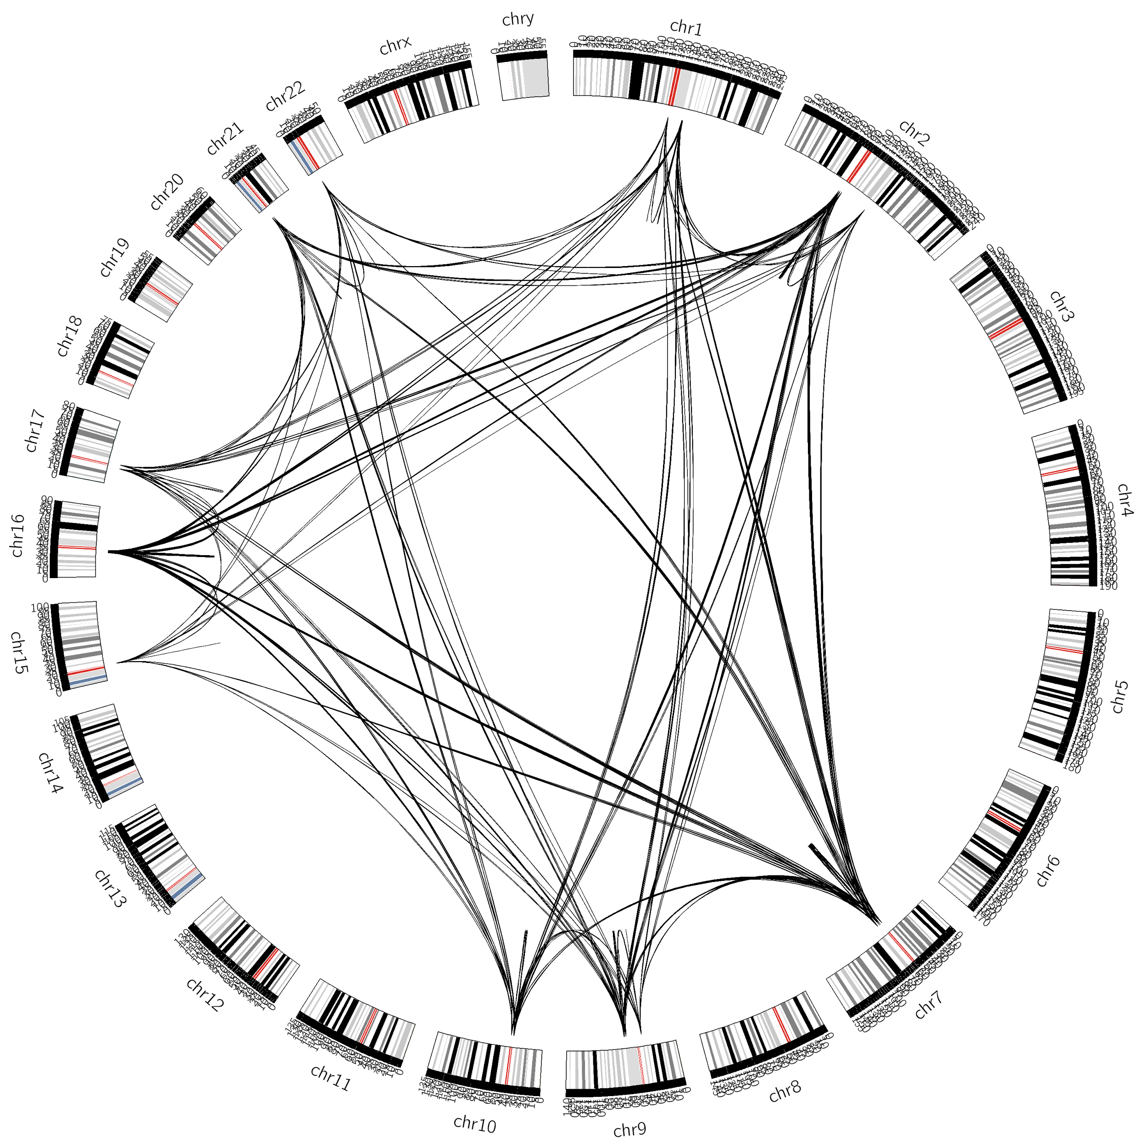
Indistinguishable TR Family with 83 members
one
family
Notes:
Circos diagram of a cluster found to have 83 members in the reference set. Bins in drawing are 1 million bp so lines which appear to link back to themselves are linking back somewhere in a 1e6 bp range.

Slide 24
VNTRs Detected

Slide 25
Subject Data
Dataset | Read Length (bp) | Coverage | Genomes
1000 Genomes | 100-101 | 5-24x | 330
CEPH 1463 | 100 | 48-109x | 17
WGS500 | 100 | 26-112x | 8
Y117 Trio | 250 | 76-77x | 3

Slide 26
VNTRs Detected
Dataset (individuals) | TRs Genotyped | Singleton TRs | All VNTRs | Singleton VNTRs | Multi VNTRs | In set VNTRs
1000 Genomes (330) | 181,594 | 153,275 | 5,140 | 3,569 | 4 | —
CEPH 1463 (17) | 180,538 | 152,619 | 2,572 | 1,659 | 11 | 226
WGS500 (8) | 177,281 | 149,989 | 2,077 | 1,407 | 10 | 261; 273
Y117 Trio (3) | 204,171 | 175,001 | 5,868 | 4,388 | 57 | 1,622
Totals (358) | 207,448 | 177,101 | 8,950 | 6,637 | 72 | —

Slide 27
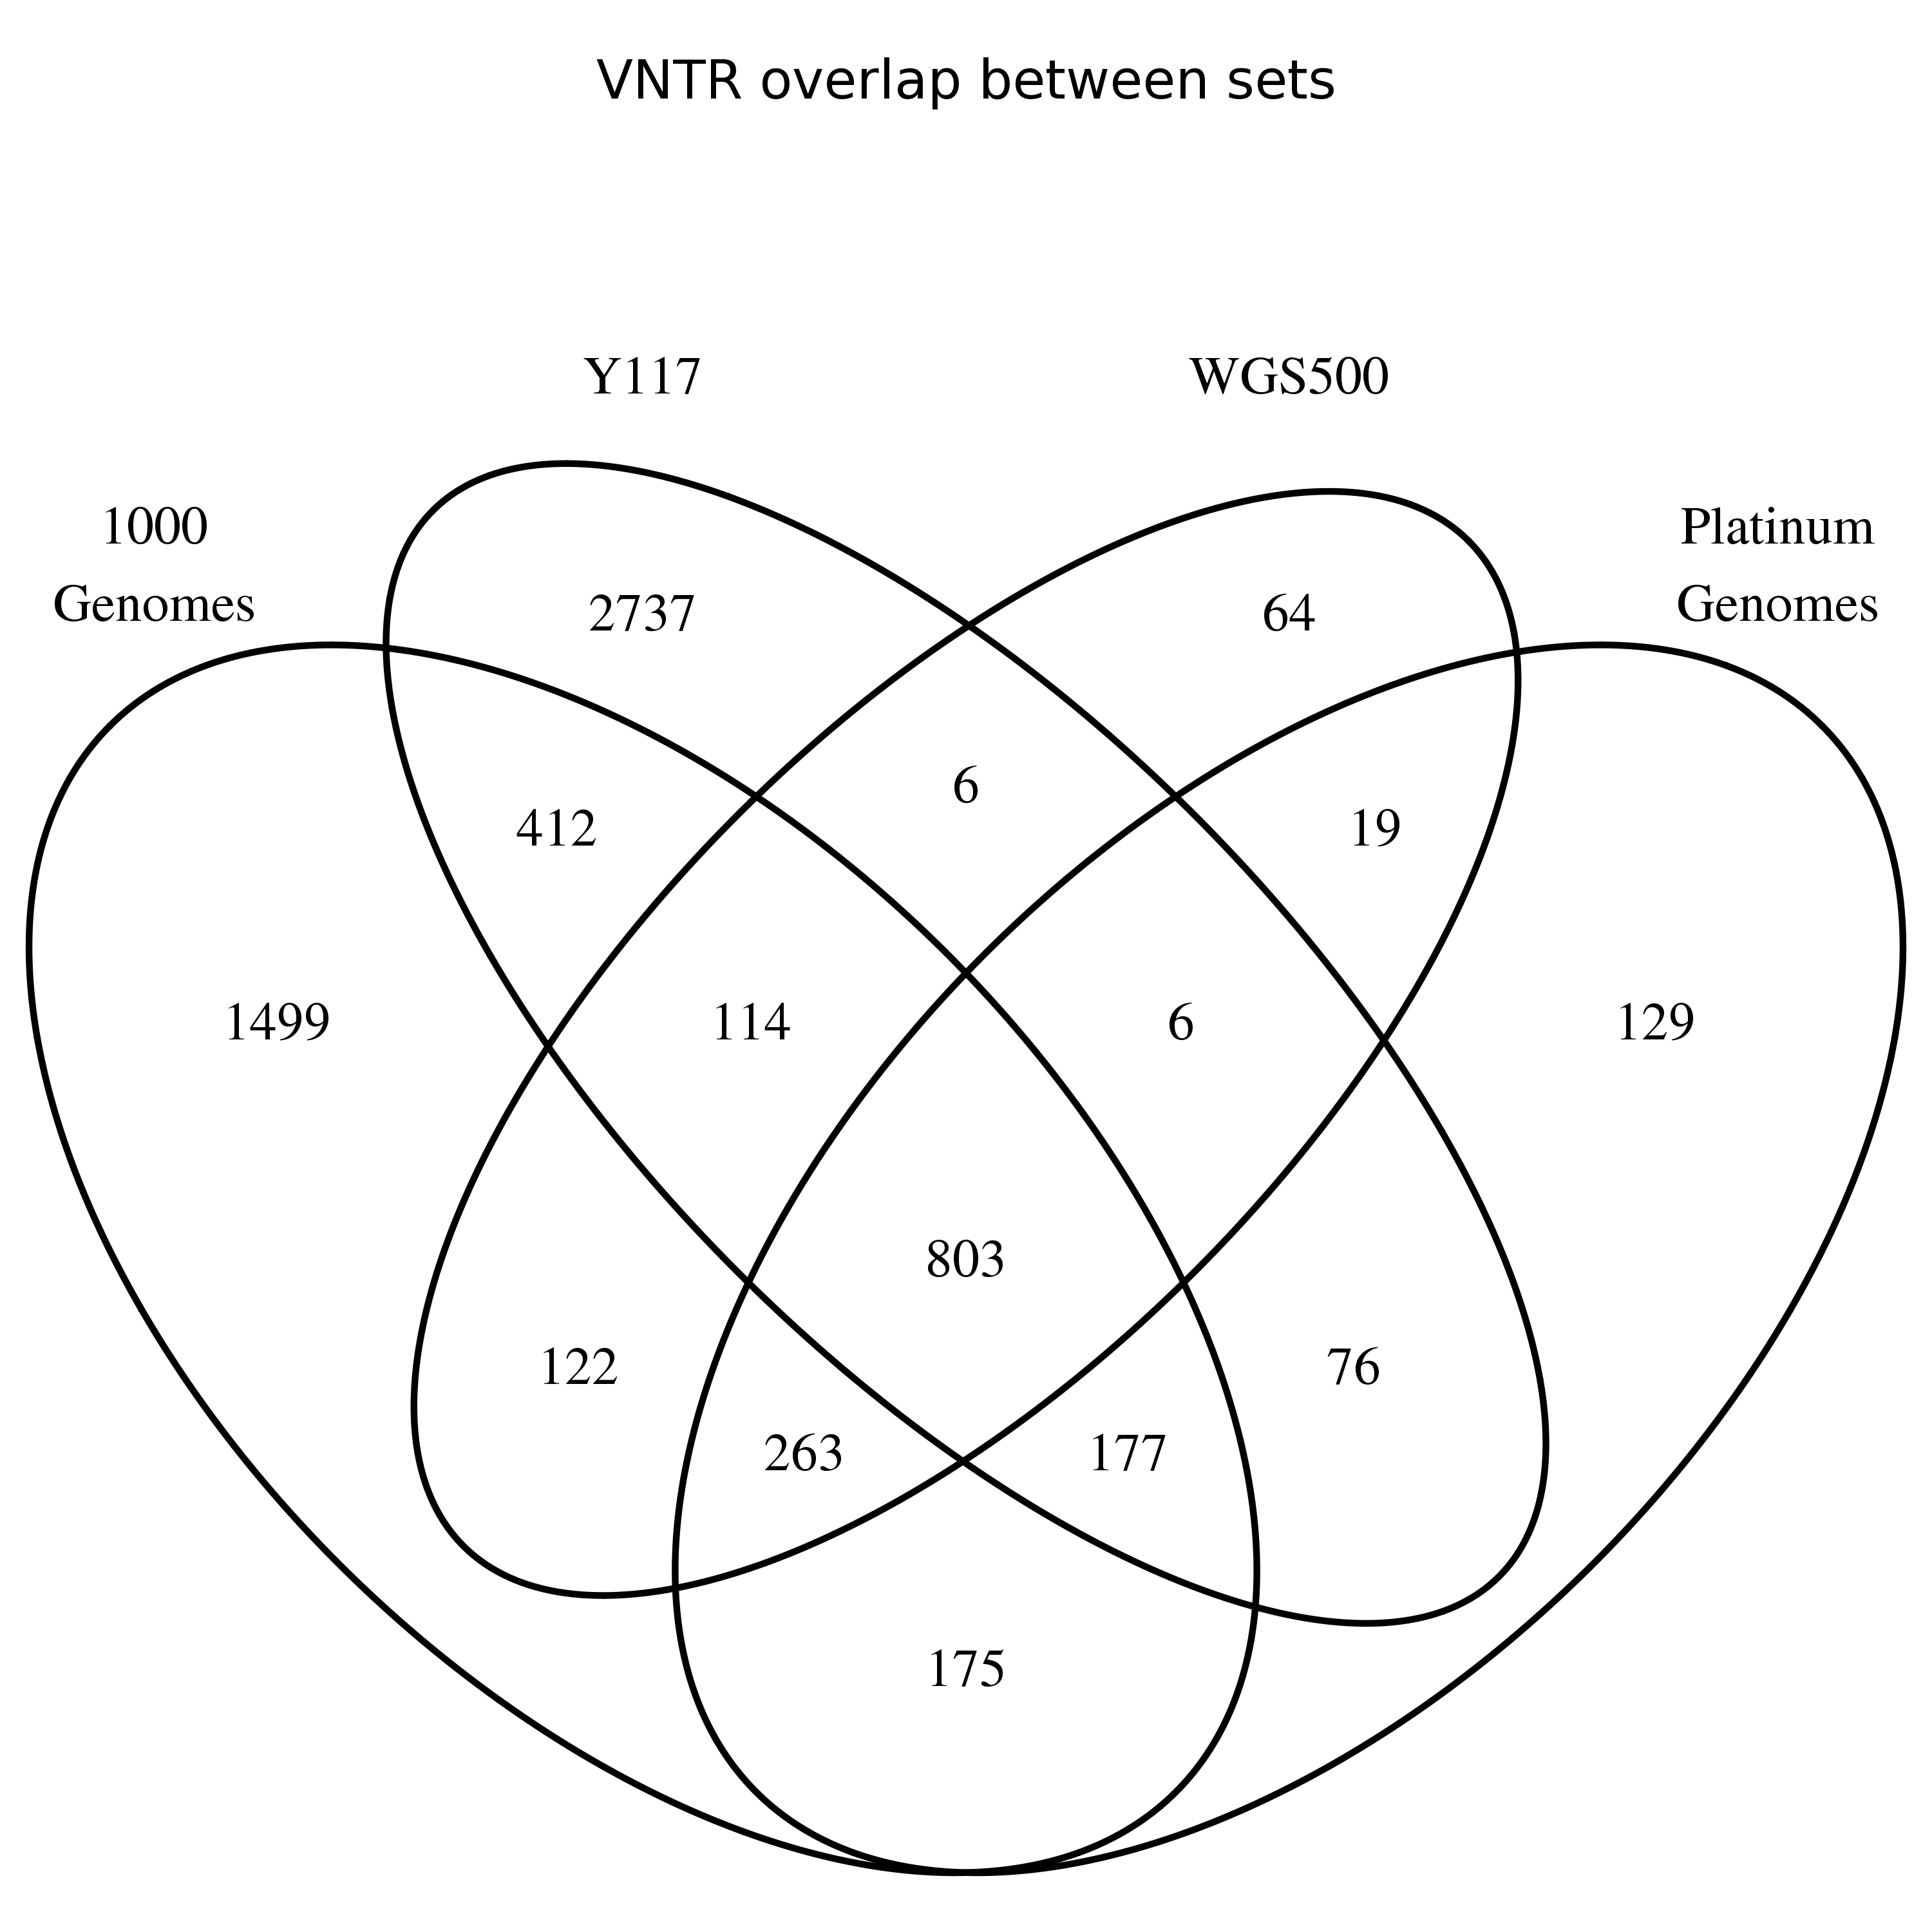
Overlap among datasets

Slide 28
VNTR Characteristics

Slide 36
Invariant TRs

Slide 38
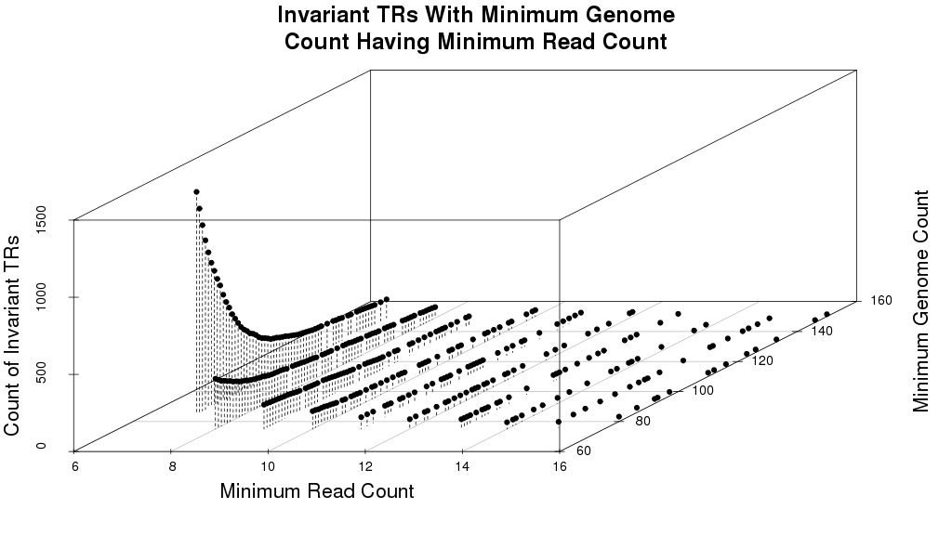
Determining Truly Invariant TRs

Slide 39
More VNTR Examples

Slide 40
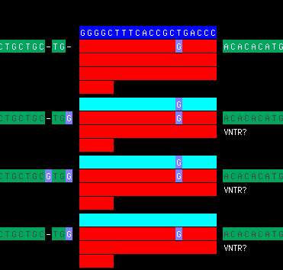
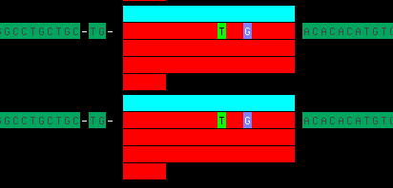
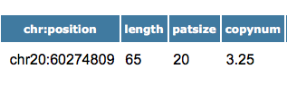
VNTR and SNP alleles

Slide 41
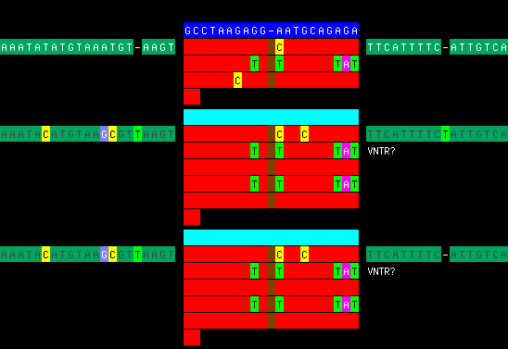
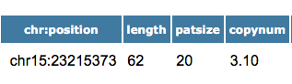
VNTR – internal motif duplicated and flanking SNPs

Slide 42
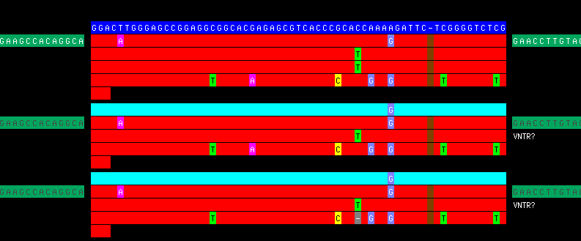
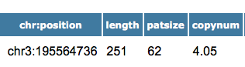
VNTR – 1 copy shorter (heterozygous?)

Slide 43
VNTR – 2 copies shorter

Slide 44
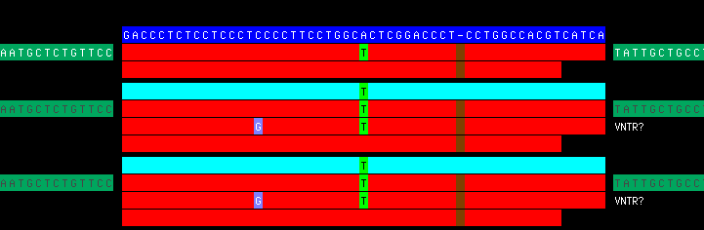
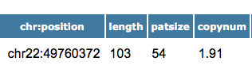
VNTR – 1 copy longer

Slide 45




Acknowledgments
Yozen Hernandez Yevgeniy Gelfand
Joshua Loving

Slide 46
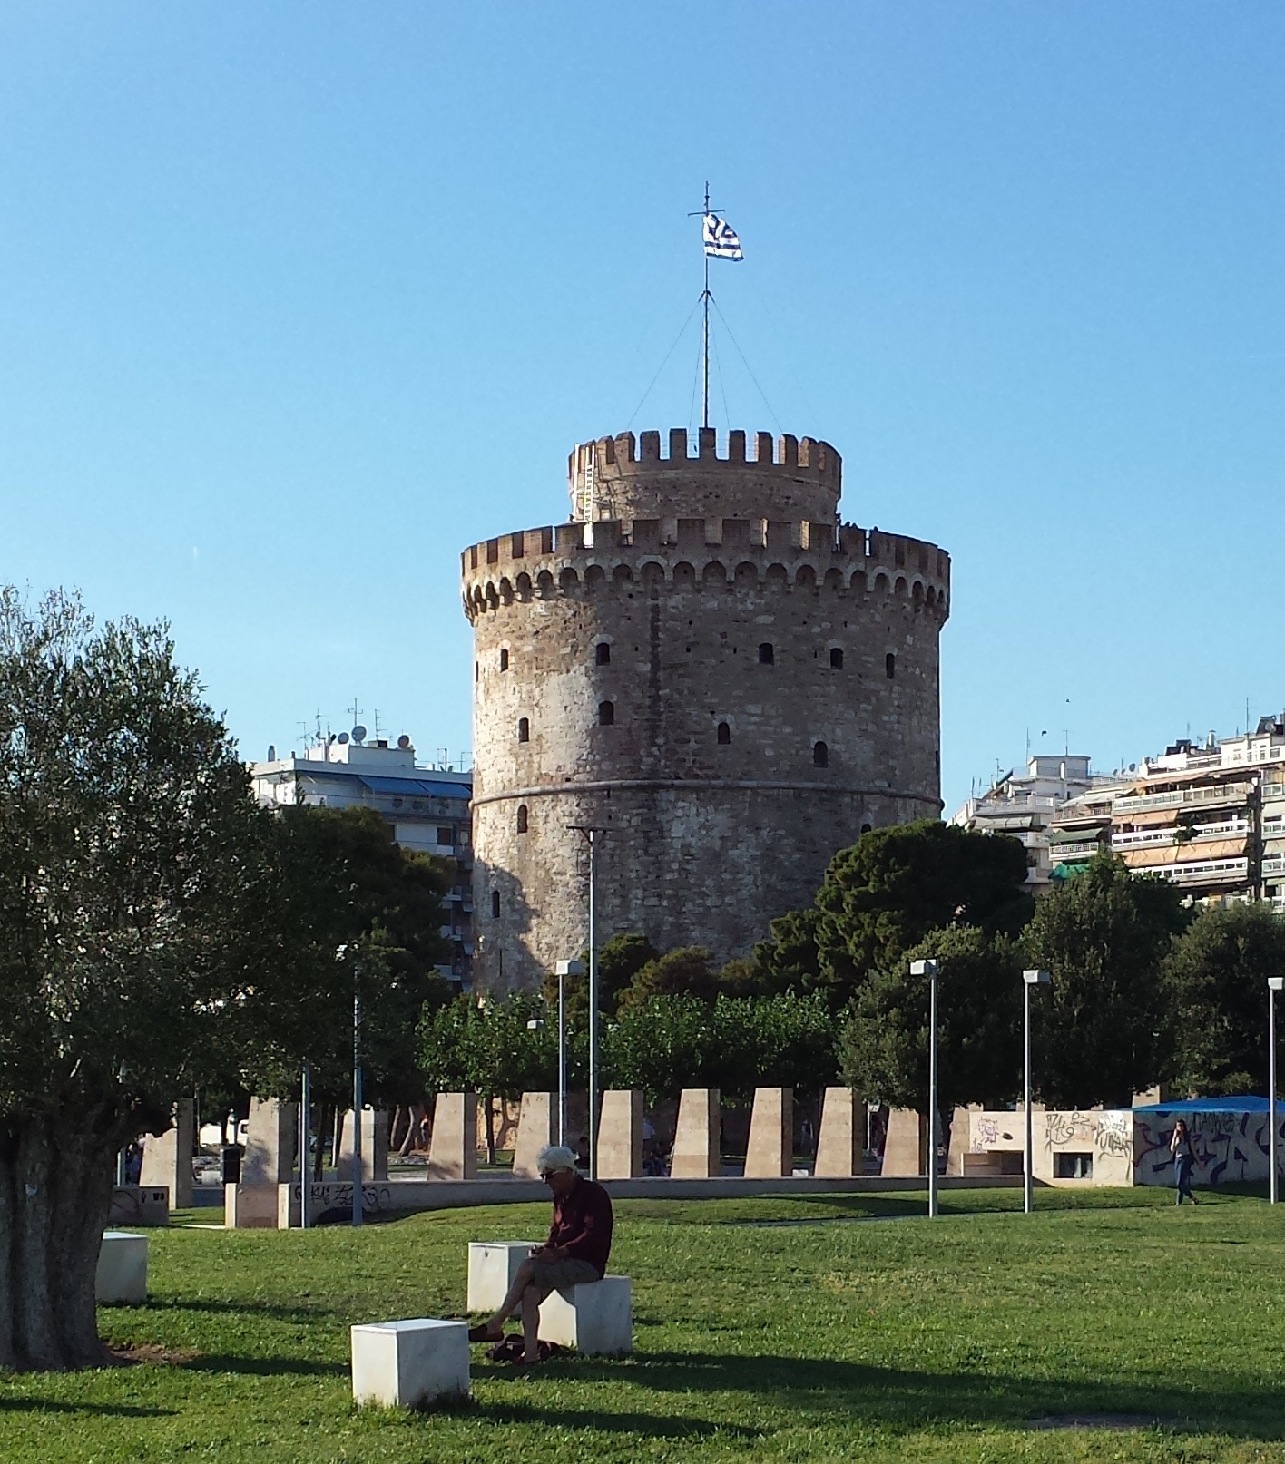

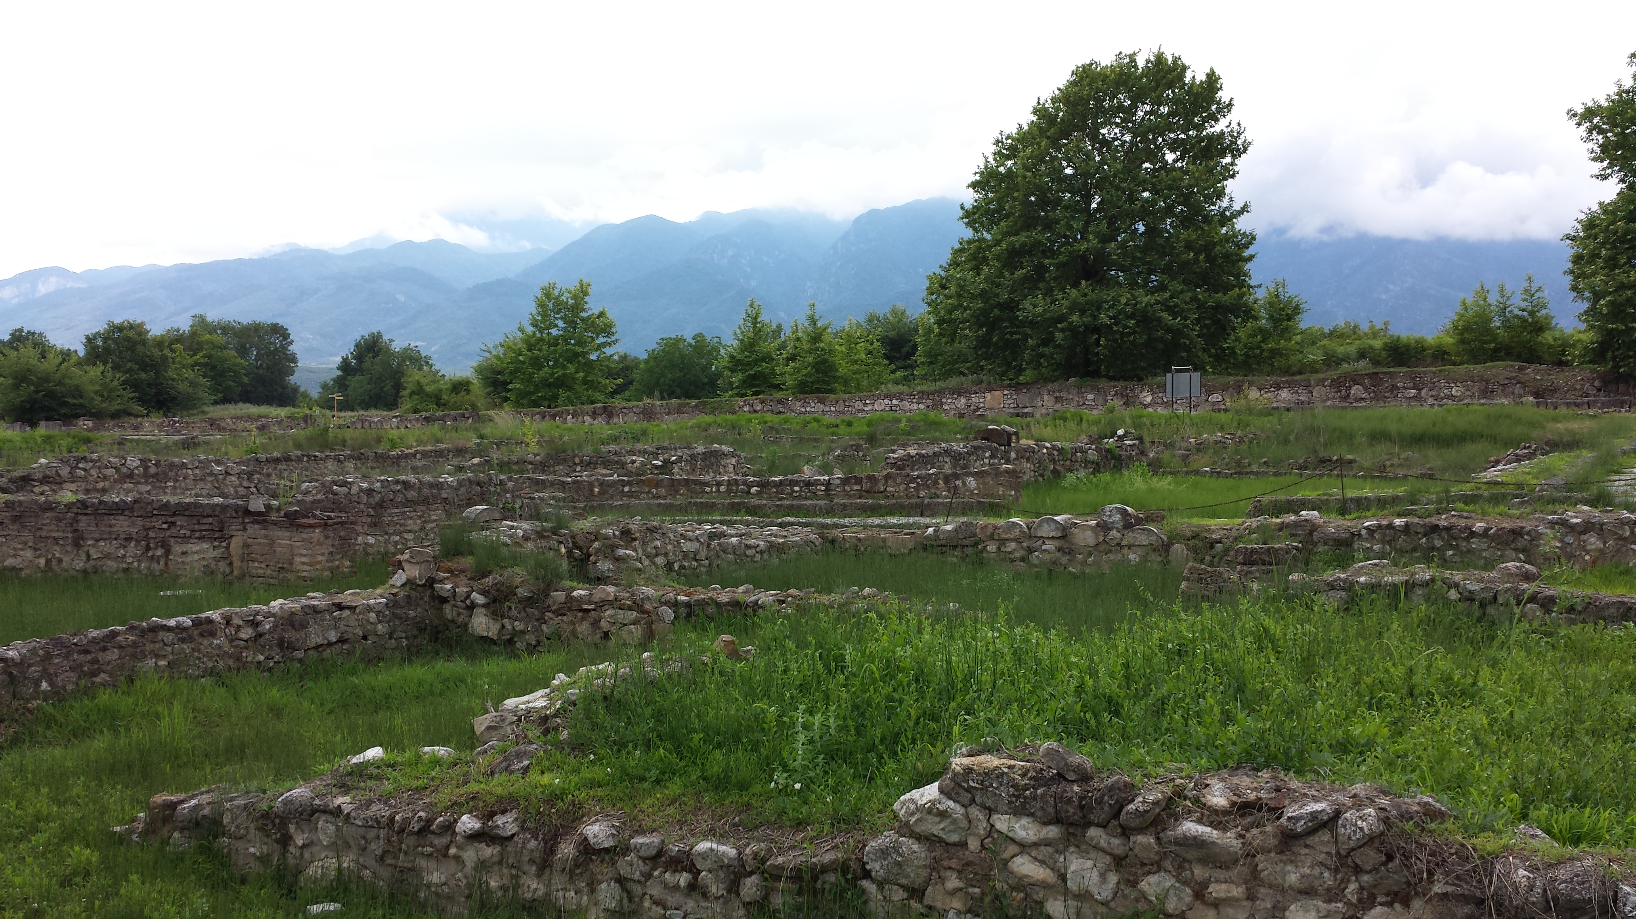
Thank you!

Slide 47

NAR – Web Server Issue
Annual Issue
Deadlines in
December
Published in
July

